Slide 1
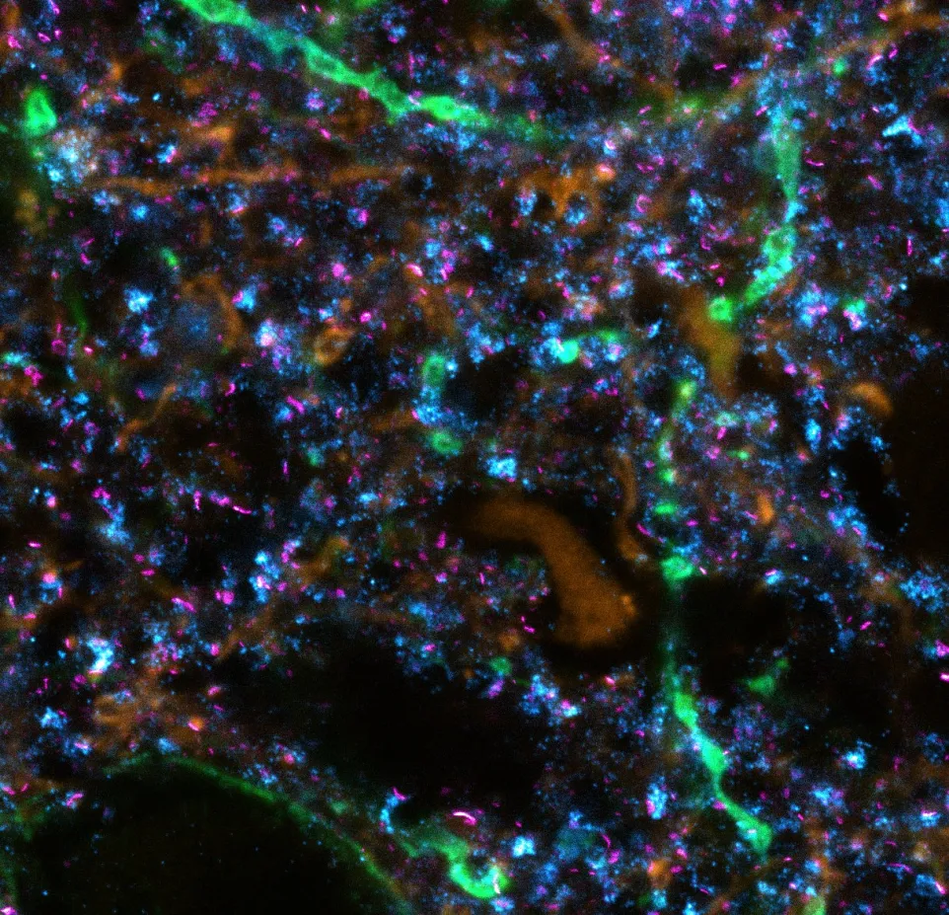
Dataset handling and structure 11.07.2026 Neurasmus Neurocomputation Workshop

Slide 2




































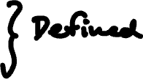





Slide 3






















Slide 4
























Notes:
Interpretability

Slide 5



















Slide 6



















Slide 7
























Slide 8



Slide 9



Slide 10
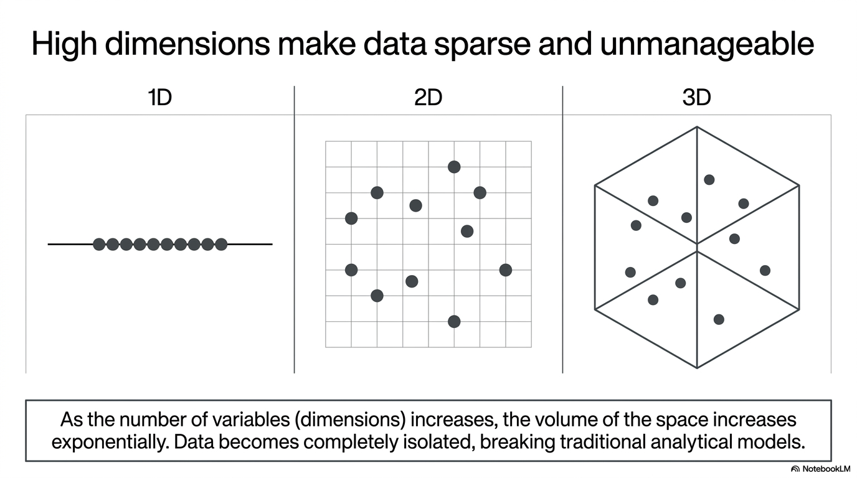

Slide 11
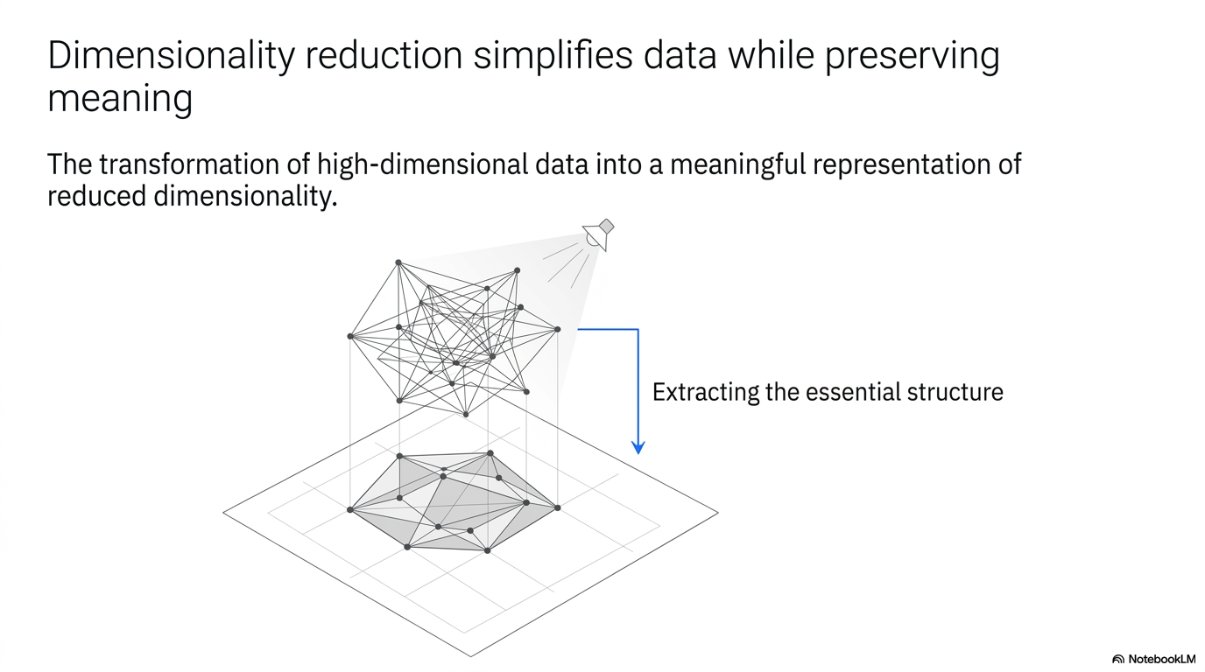

Slide 12
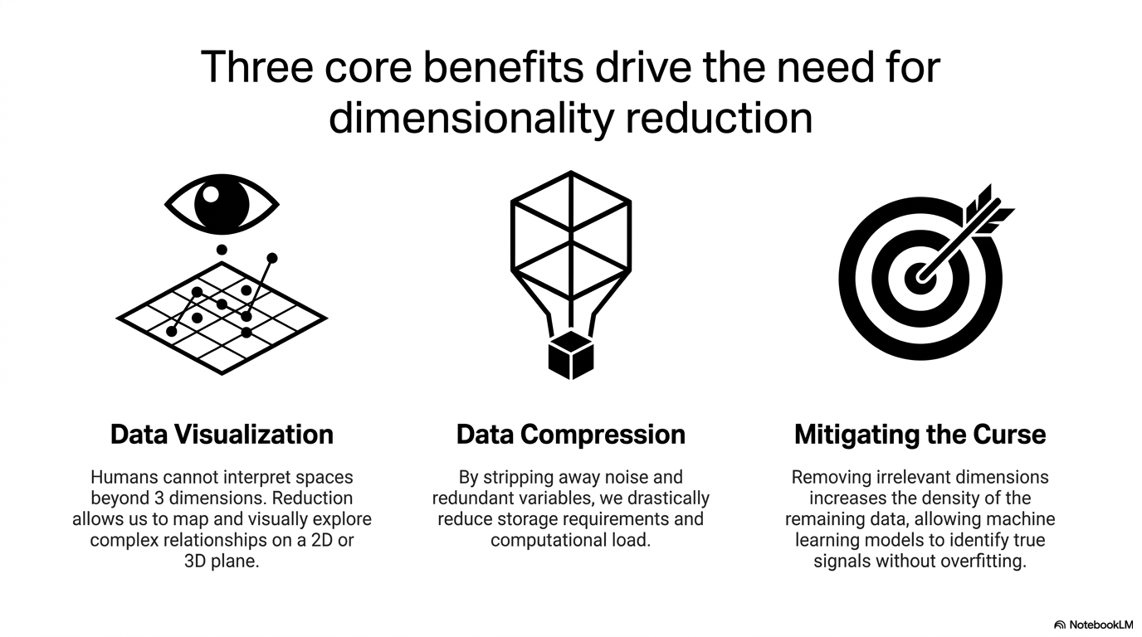

Slide 13















Slide 14



















Slide 15































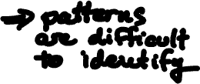


Slide 16

























Slide 17










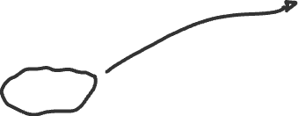









Slide 18
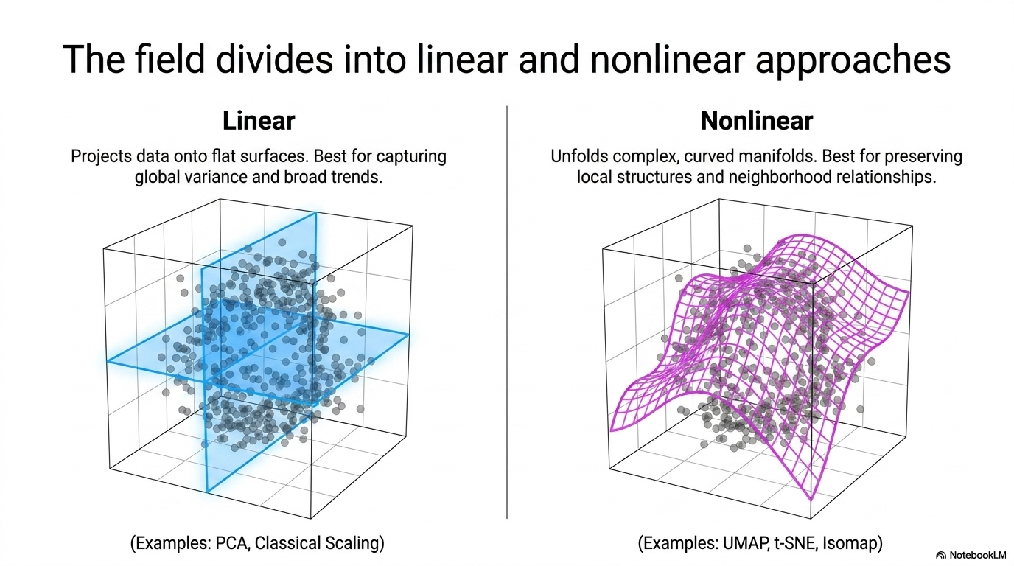

Slide 19
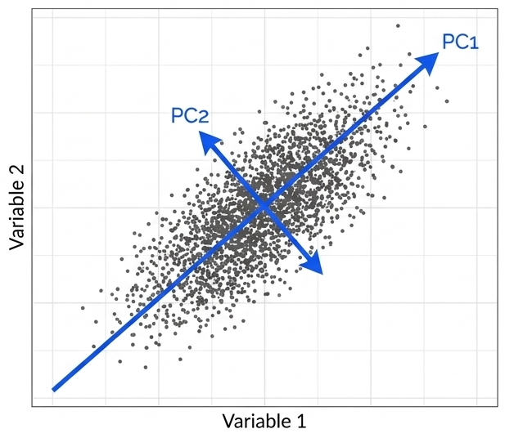





Linear statistical method to translate complex multidimensional datasets into their essential features – the principal components
Identifies a small number of linear combinations of the original variables that maximally explain the total variance in the data.
The first principal component (PC1) accounts for the greatest variation,
Subsequent components (PC2, PC3, etc.) explain the remaining residual variance while remaining uncorrelated with previous components.
Notes:
PCA is a versatile linear statistical method used to reduce a complex data table to its essential features, known as principal components.
Mechanism: It identifies a small number of linear combinations of the original variables that maximally explain the total variance in the data. The first principal component (PC1) accounts for the greatest variation, with subsequent components (PC2, PC3, etc.) explaining the remaining residual variance while remaining uncorrelated with previous components.
Computation: The process typically involves an eigenvalue decomposition (EVD) of the covariance matrix or a singular value decomposition (SVD) of the data matrix.
Applications: It is often used for data visualization through biplots, which map both the cases (subjects) and the original variables to interpret relationships and correlations.
Limitations: As a linear technique, PCA may fail to adequately capture the structure of complex nonlinear manifolds, such as the "Swiss roll" dataset.

Slide 20
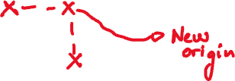
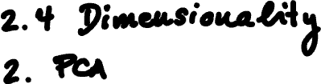



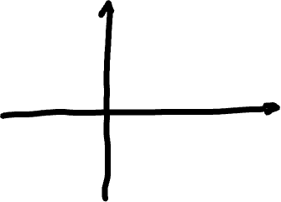






Slide 21






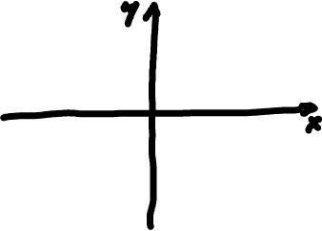











Slide 22

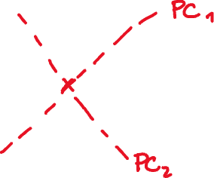

















Slide 23





















Slide 24
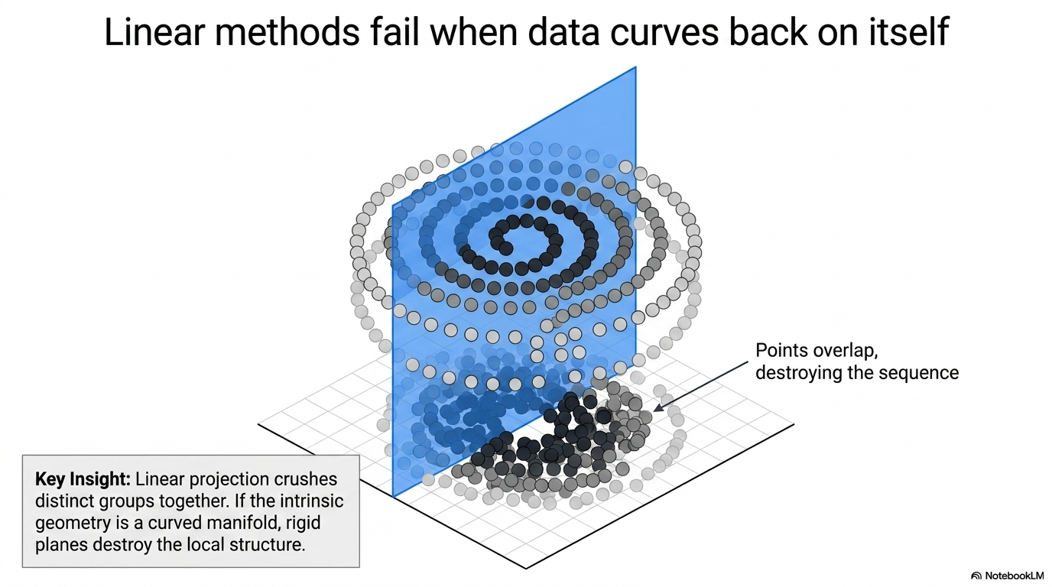

Slide 25
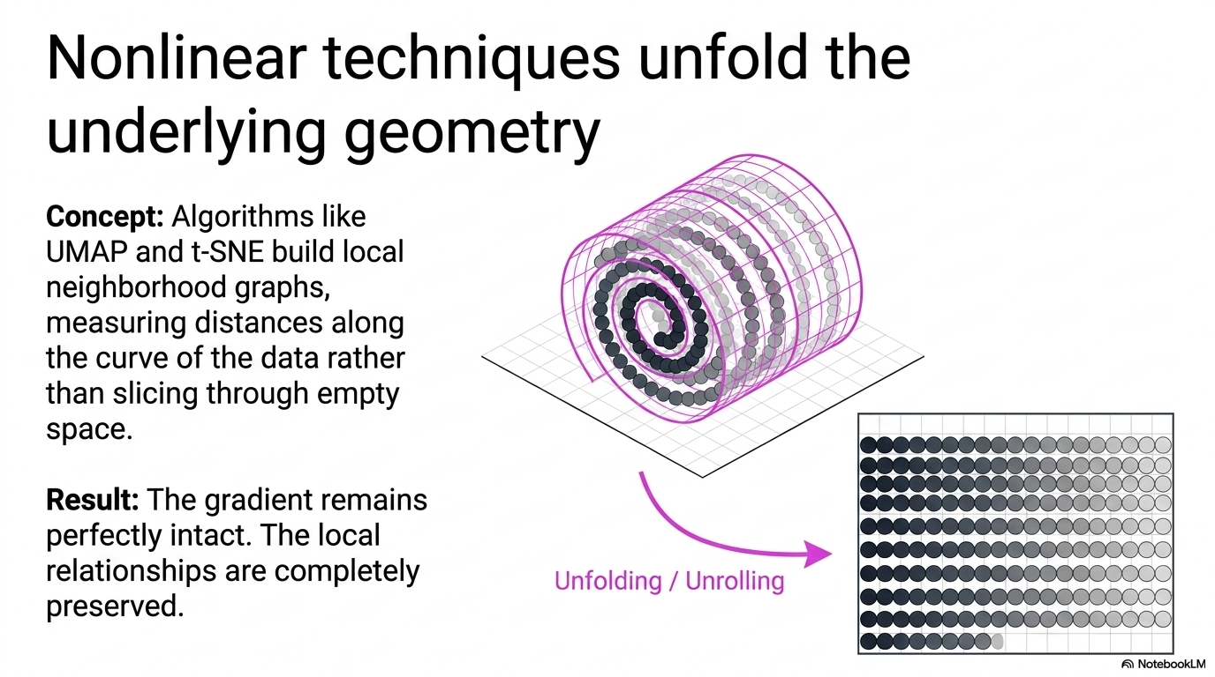

Slide 26
2. 4 Dimensionality reduction 4. t-SNE (t-distributed Stochastic Neighbor Embedding)
Non-linear dimensionality reduction technique
It models data point in a high-dimensional space by a point in a two- or three-dimensional space that can be vizualised
Similar objects are modeled by nearby points, dissimilar objects are modeled by distant points
T-SNE uses the Stochastic Neighbor Embedding algorithm that converts high-dimensional Eucledian distances between data points into probabilities associated with data similarities
SNE algorithm converts the high-dimensional Euclidean distances between data points into conditional probability
If you apply t-SNE to high-dimensional but well-clustered data, it tends to produce a visualisation with distinctly isolated clusters.
t-SNE has challenges preserving global data structure
Notes:
Informally, the algorithm places all points on the 2D plane, initially at random positions, and lets them interact as if they were physical particles. The interaction is governed by two laws: first, all points are repelled from each other; second, each point is attracted to its nearest neighbours (see Methods for a mathematical description). The most important parameter of t-SNE, called perplexity, controls the width of the Gaussian kernel used to compute similarities between points and effectively governs how many of its nearest neighbours each point is attracted to.

Slide 27











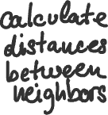









Slide 28















Slide 29













Slide 30
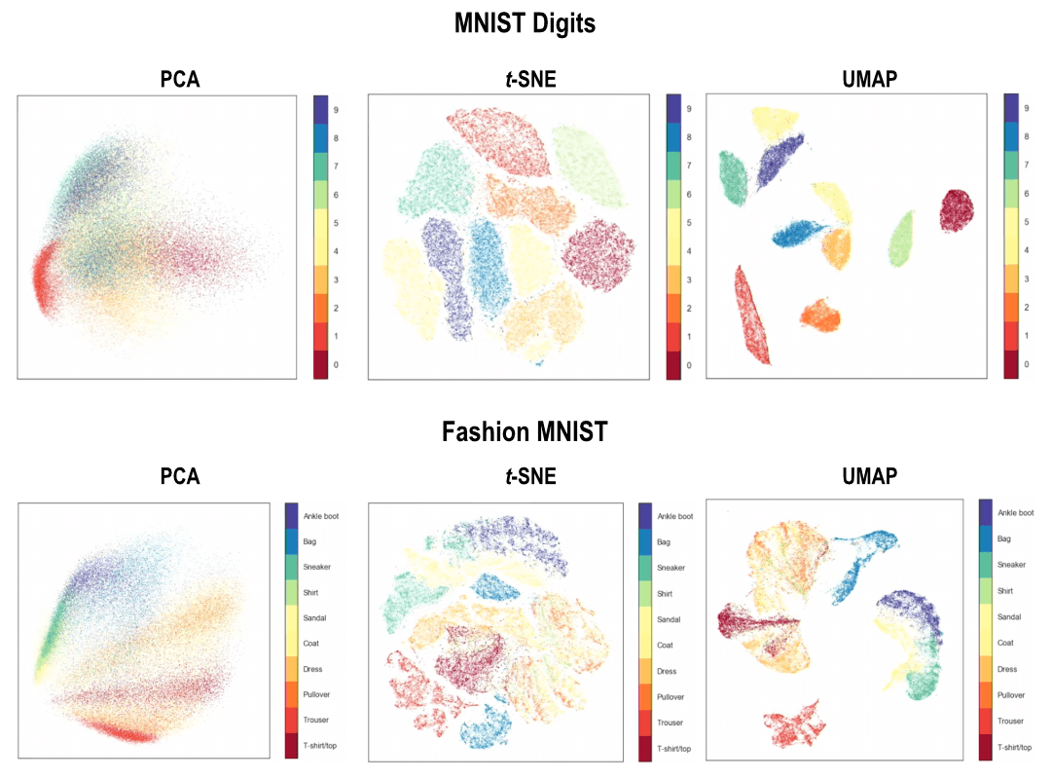
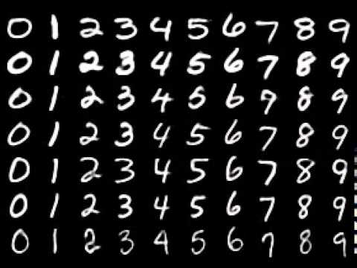
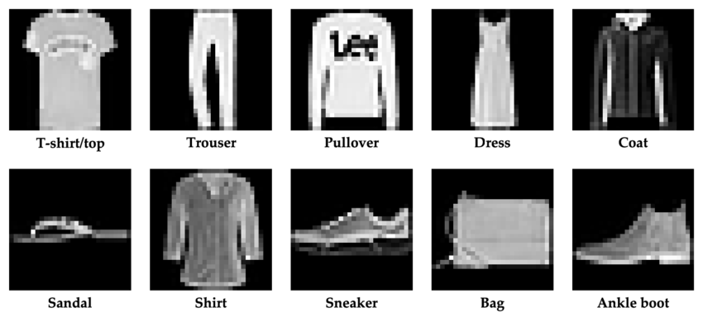
https://meta.caspershire.net/umap/

Slide 31



























Slide 32
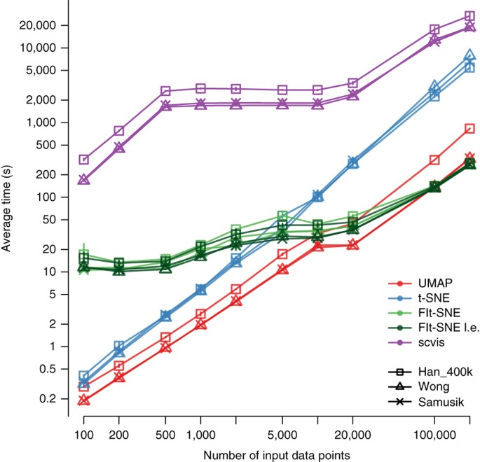
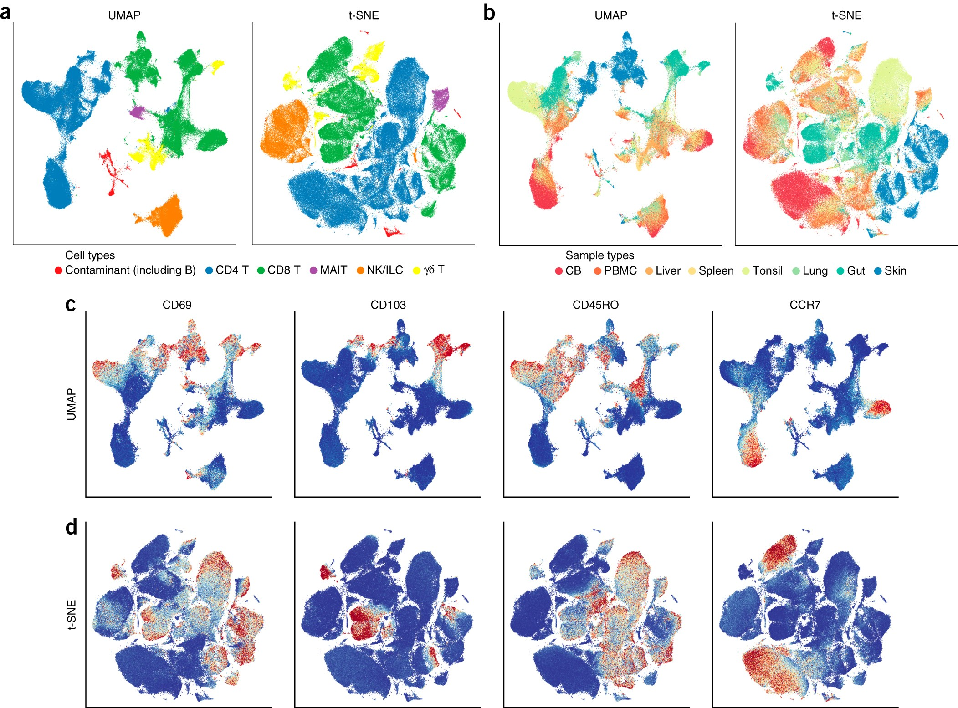

Run times of five dimensionality reduction methods for inputs of varying sizes
UMAP embeds local and large-scale structure of the data
Becht, E., McInnes, L., Healy, J. et al. Dimensionality reduction for visualizing single-cell data using UMAP. Nat Biotechnol 37, 38–44 (2019). https://doi.org/10.1038/nbt.4314

